Slide 1
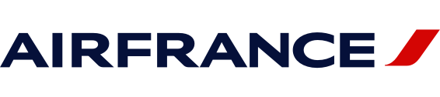
How to gain MORE PROFIT in the US
Team 9
Saviera Ubas Mayank Handa Manafumi Yaguchi Haiyan Hu Valeria Ramirez H

Slide 2



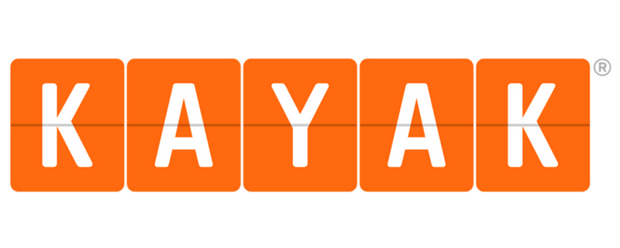
Problem Statement
Which channel or campaign will generate the most profit in the US

Slide 3
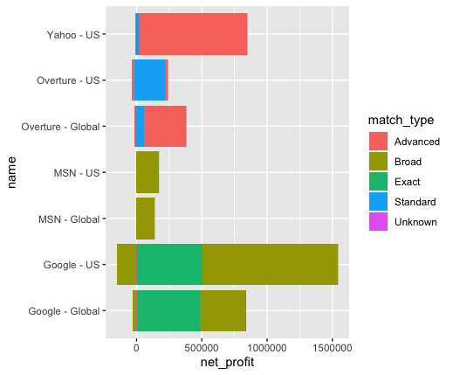
Most profitable channel
Which match type brings in profits?
Google US makes about $1m net profit from Broad Type Keywords.
Exact keywords occupied 1/3 total profits of Google US.
MSN and MSN Global brings profit from Broad Type.
Yahoo-US uses advanced type to generate profits

Slide 4
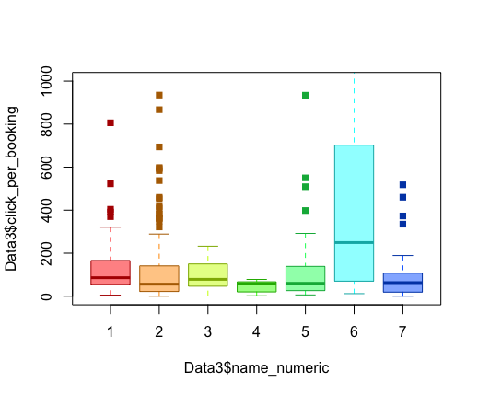
Clicks per booking
On average, it takes Overture US 200 clicks to complete one booking. Other channels only take 100 clicks.

Slide 5
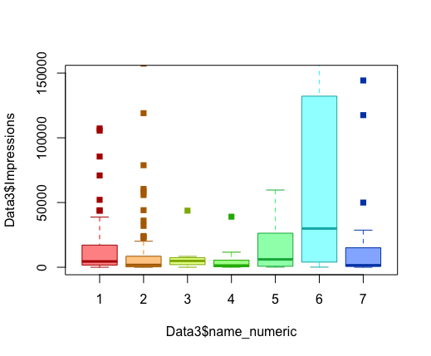
Impressions per Channel
Overture US has extremely high impressions comparing with other channels.

Slide 6
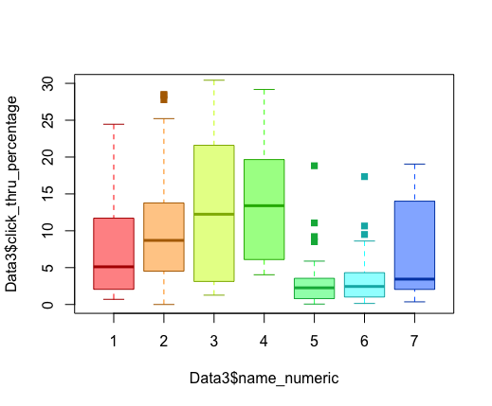
Click through Percentage
This plot, the click through rate, is one of the lowest.
They are not targeting the right audiences

Slide 7
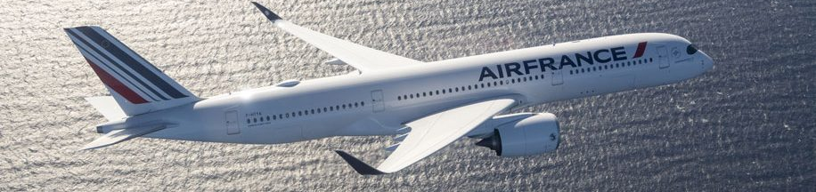
Customized Score for Keywords
50% x net profit +
(30% x trans-conv %) +
(20% x click thru%)
Team 9-Score =
Notes:
(click) We built a predictive model to measure the performance of keywords. We took 0.5 weight from net profit, 0.3 weight from transaction conversion ratio, and 0.2 weight from click through%.
Through this we understand the higher profit the keyword brings, the higher conversion ratio it has, and the higher click thru% it has, the better the performance.
We look into the descriptive data of this score. We set a threshold as 435, which is the mean score, to determine whether the keyword is working fine. So that we can predict the performance of the keyword in the future..

Slide 8
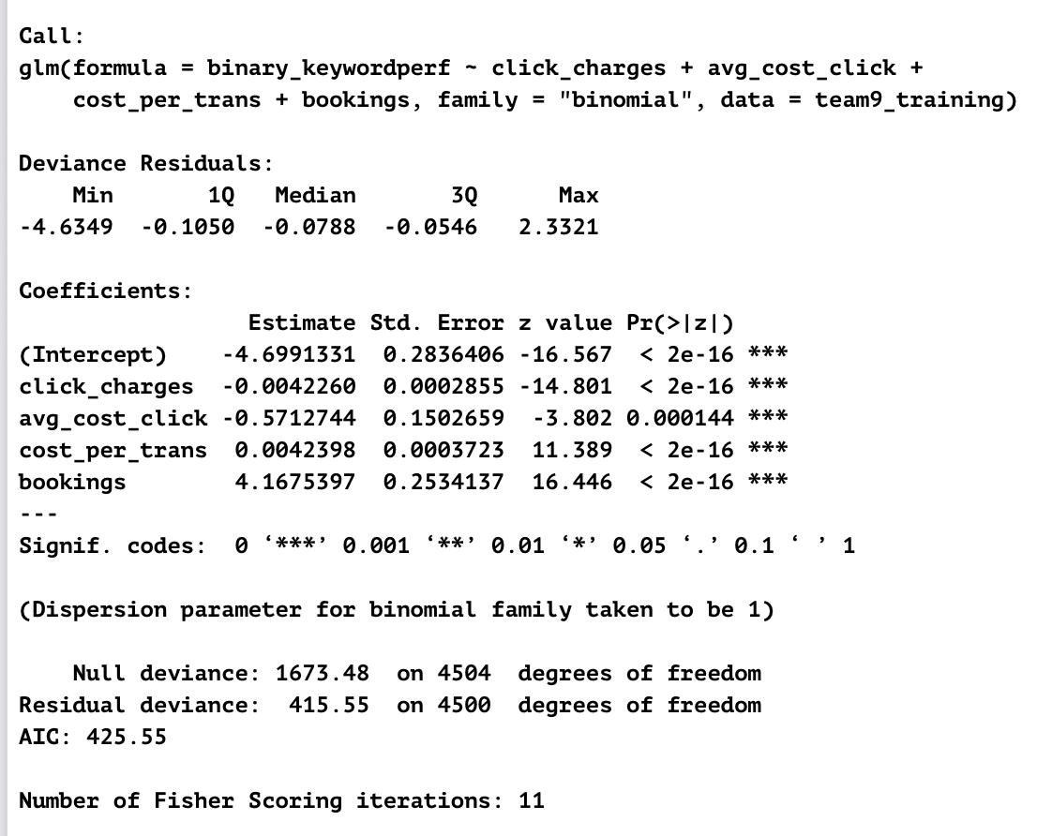
Logistic Regression Model
Logistic regression model shows that the coefficients for variables click-charges, average cost per click, cost per transaction and bookings are all significant
Notes:
If 1 unit increase in click charges, the success of odds will decrease about 0.44% (click)
If 1 unit increase is average cost per click, the success of odds will decrease about 43.5%
If there is 1 unit increase in cost per transaction, the success of odds will increase about 0.42%. (click)
If there is one unit increase in bookings, the success of odds will increase about 63 times.

Slide 9
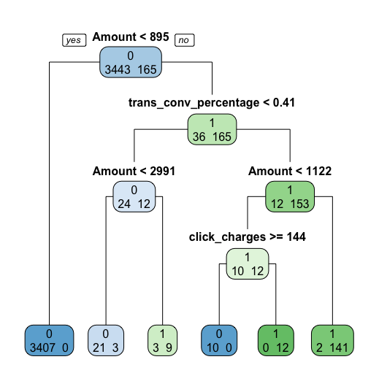
Decision Tree
amount-$1513
transaction conversion % 7.69%,
click charges $5.21,
1 = Success!
This means the key word is good and working fine; a result of 0 would mean it’s not performing well.
Notes:
In this decision tree, we used this example (click)
Since 1513 the Amount = Revenue the keyword brings, is greater than 895 (click), then we go to the right to trans conv percentage(click).
At trans_conv percentage, if this is more than 0.41%, then we go to the right to Amount (click)
At Amount, if this is more than 1122, then we go right. (click) Reaching a conclusion of 1 indicates that they keyword is successful.
Here, the decision tree does not guide us to click charges so we can ignore this item in the example.
(click) Where by 1 interprets to success, meaning the score we used in the previous slides is above the mean. So this key word is working fine

Slide 10


What is going to generate the most revenue for Air France
Continue to use Google as a channel
Cut ties with MSN
Potential to gain more profits through other channels
Notes:
We recommend: (click)
Continue working with Google search engine as a channel to run campaigns as they reap the most revenue (click)
They can end ties with MSN as it does not generate favorable amounts of revenue
There is a potential to gain more profits through other channels such as Google, Yahoo and Kayak

Slide 11
What is going to generate the most revenue for Air France
Yahoo acquired Overture in 2006
High Impression but low click through rate
Improve campaigns
Use logistic regression or decision tree to monitor performance of keywords
Notes:
We recommend: (click)
Yahoo has been acquired by yahoo
They have high impressions, but one of the lowest click through rate
The quality of campaigns need to be improved should Air France choose to continue working through them
Use logistic regression or decision tree to monitor performance of keywords

Slide 12



What is going to generate the most revenue for Air France
Do not spend money on clicks & impressions
Instead, spend money to increase conversion ratio or bookings
Notes:
Based on the logistic regression model we saw, we recommend
Do not spend money on clicks & impressions
Instead, spend money to increase conversion ratio or bookings

Slide 13
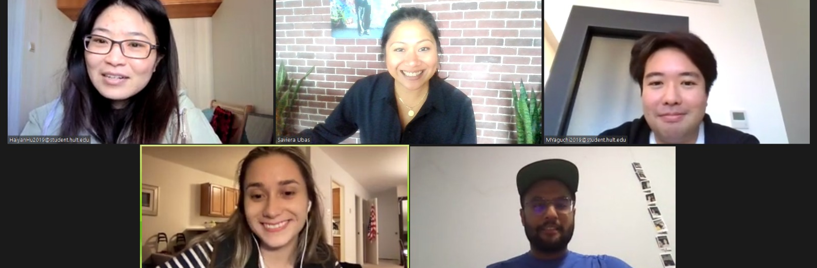

China
Hong Kong
Japan
San Francisco
San Francisco
Thank you!
Video link: https://youtu.be/Txd4vKNzN0g

